Slide 1




HOSPITAL MANAGEMENT SYSTEM
Sunil Kumar Prusty
Sunilprusty16@gmail.Com

Slide 2

Objective
To develop a comprehensive SQL database for the hospital management system that enables efficient data analysis.
2. Design the database schema to include the following tables:
Doctors: Contains information about each doctor.
Departments: Contains information about each department.
Doctor_Department_Assignment: Contains the relationships between doctors and departments
3.Analyze the data between physician,department,patient and nurse.

Slide 3
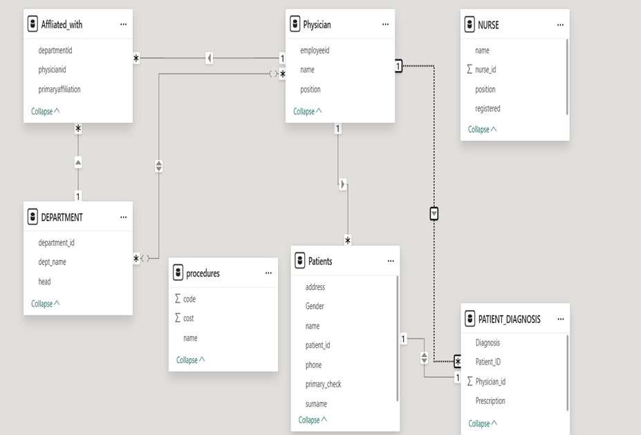
ER-Diagram (Entity Relationship Diagram) For Hospital Management System.

Slide 4
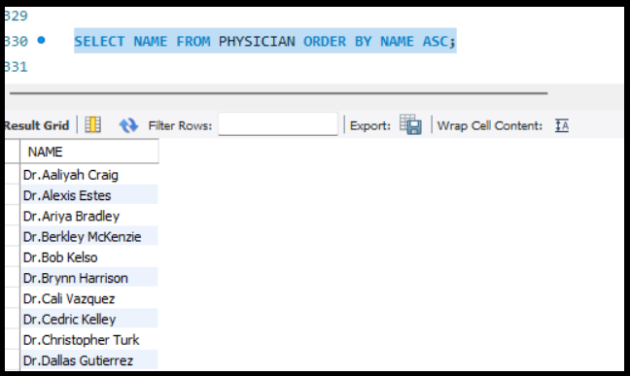

1.Write a query in SQL to obtain the name of the physician in alphabetical order.

Slide 5

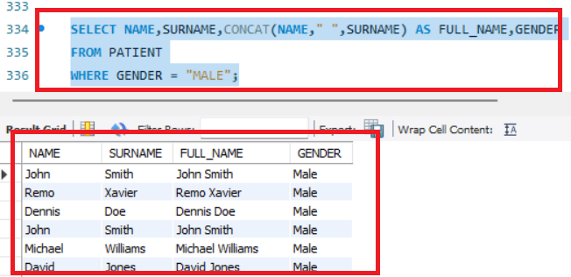
2.Write a query in SQL to obtain the full name of the patients whose gender is male.

Slide 6
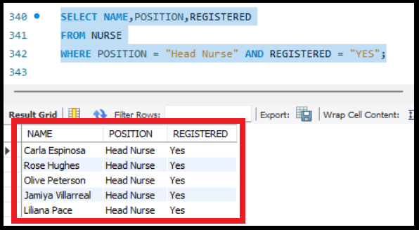

3.Write a query in SQL to find the name of the nurse who are the head of their department and are registered.

Slide 7

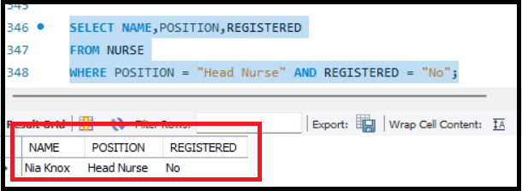
4.Write a query in SQL to find the name of the nurse who are Team Leader or not registered.

Slide 8
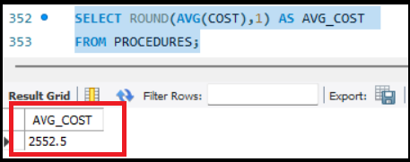

5.Write a query to obtain the average cost of all the medical procedures.

Slide 9
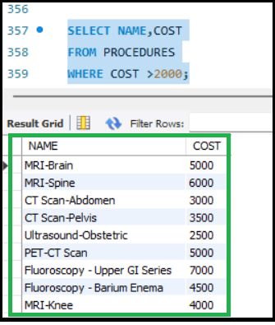

6.Write a query to obtain name and cost of the procedure whose cost is greater than 2000.

Slide 10
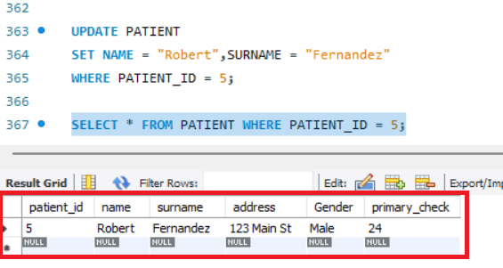

7.Write a query to update the name of the patient to Robert Fernandez having patient id as 5.

Slide 11
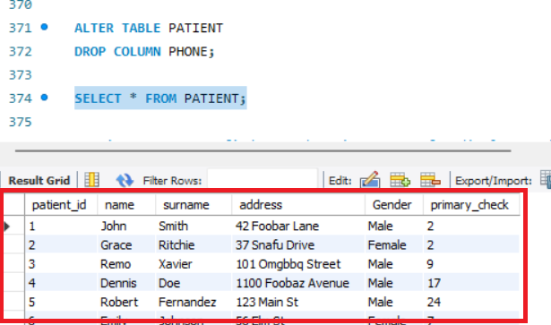

8.Write a query to drop phone column from patient table

Slide 12
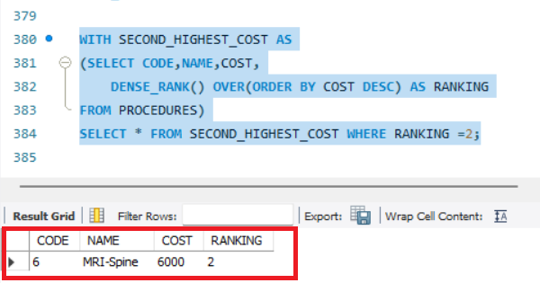
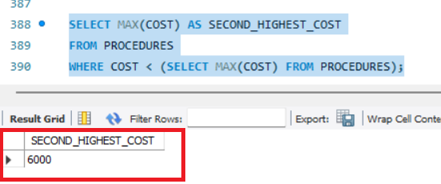
9.Write a query to find second maximum cost of medical procedure?

Slide 13
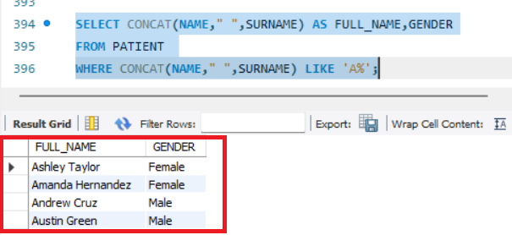

10.Write a query in SQL to obtain the name of the patients starting with letter A.

Slide 14
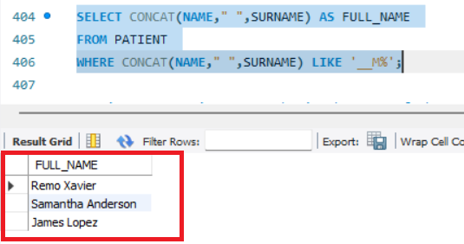

11. Write a query in SQL to obtain the name of the patients whose third letter is M.

Slide 15

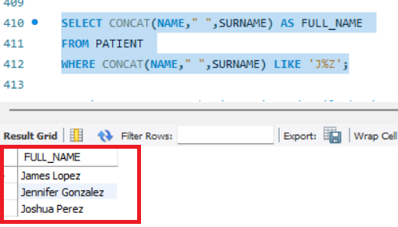
12.Write a query in SQL to obtain the name of the patients whose name start with letter J and ends with Z.

Slide 16
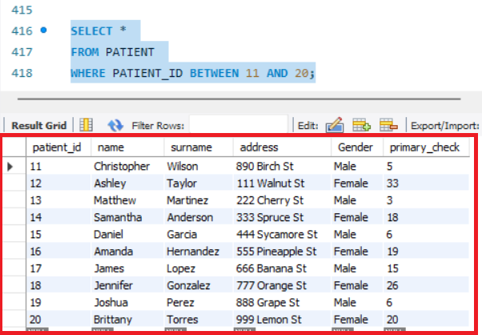

13. Write a query to obtain patient details having patient id 11 to 20.

Slide 17
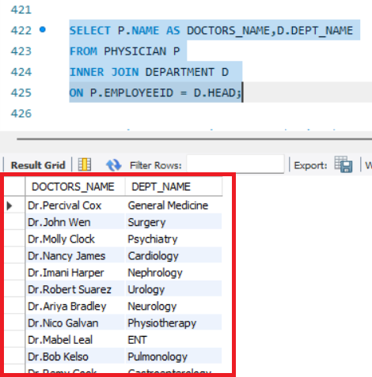
14.Write a query in SQL to obtain the name of the physicians who are the head of each department
.

Slide 18
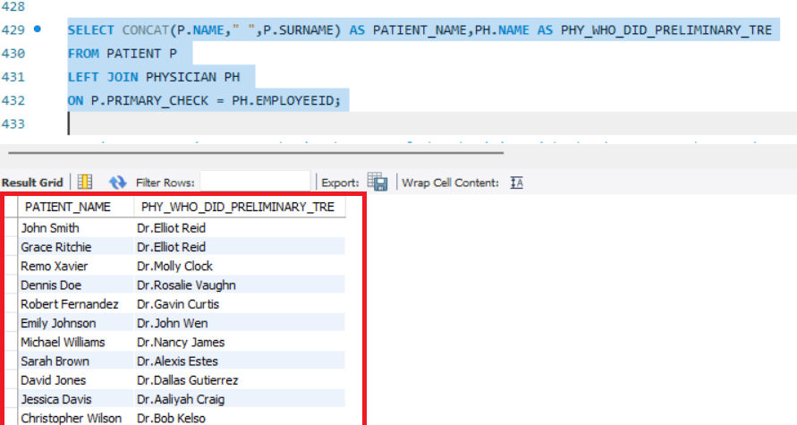

15. Write a query in SQL to obtain the name of the patients with their physicians by whom they got their preliminary treatment

Slide 19
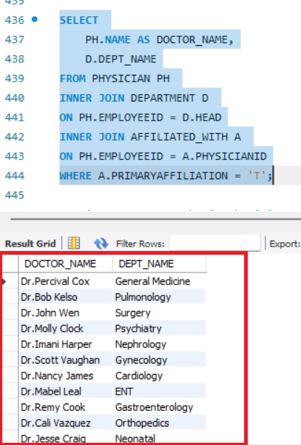
16.Write a query in SQL to obtain the name of the physician with the department who are done with affiliation.

Slide 20
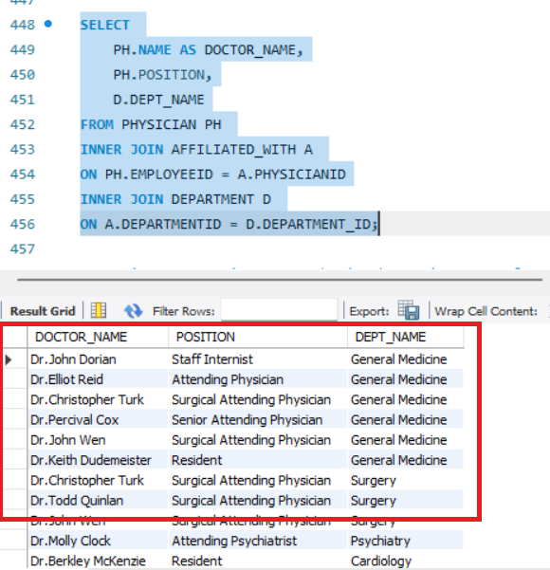
17.Write a query to obtain physician name, position and department they are affiliated with.

Slide 21

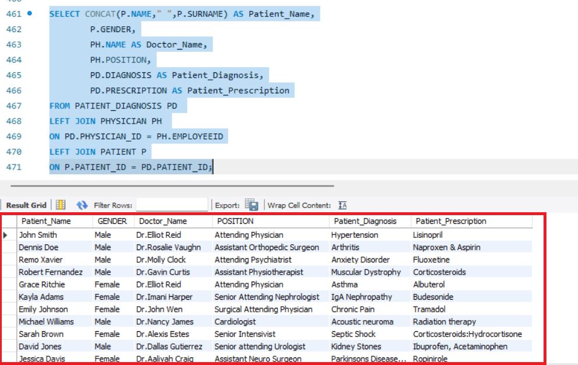
18.Write a query in SQL to obtain the patient name from which physician they get primary checkup and also mention the patient diagnosis with prescription.

Slide 22
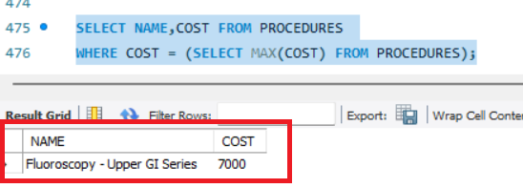
19. Write a query in SQL to obtain the maximum cost of the medical procedure.

Slide 23
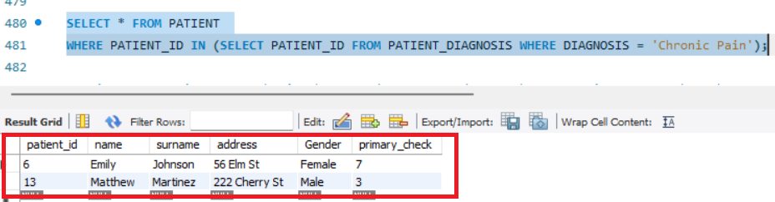
20. Write a query in SQL to obtain the details of patient who has diagnosed with chronic pain.

Slide 24
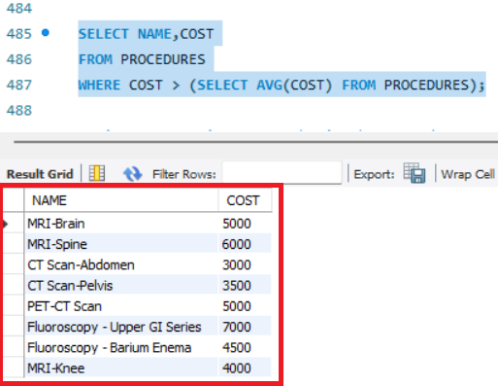

21. Write a query in SQL to obtain the procedure name and cost whose cost is greater than the average cost of all the procedure.

Slide 25
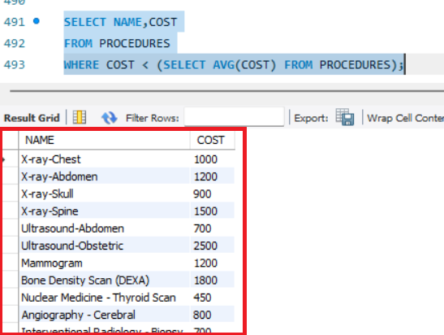
22. Write a query in SQL to obtain the procedure name and cost whose cost is less than the average cost of all the procedure.

Slide 26
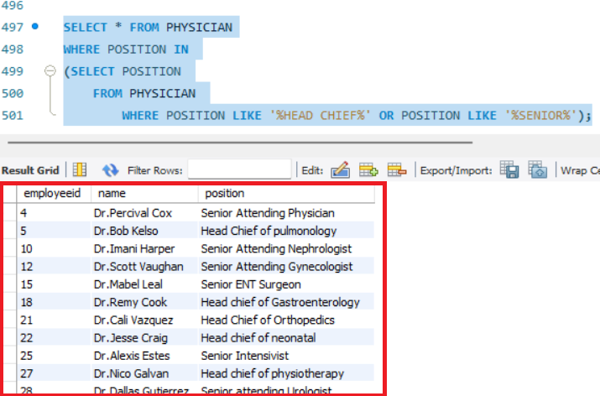
23. Write a query in SQL to obtain the physician name who are either head chief or senior in their respective department.

Slide 27
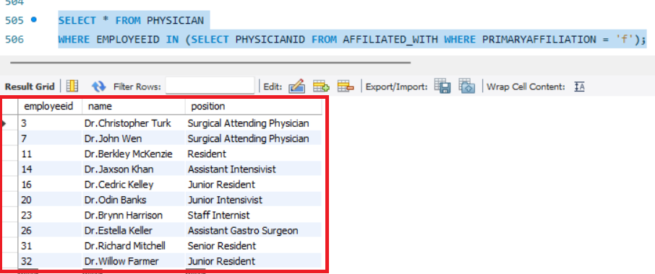
24. Write a query in SQL to obtain the employee id, physician name and position whose primary affiliation has not been done.

Slide 28
Conclusion: -
this SQL Project demonstrates a significant step toward modernizing hospital management processes. By designing and developing an efficient database management system, we aim to enhance the accessibility, organization, and reliability of patient and hospital data. The conceptual and logical designs, illustrated through the EER diagram and relational schema, provide a solid foundation for implementation. With well-defined data types and constraints, the project ensures data integrity and accuracy.
Moving forward, the implementation and iterative improvement of this system will pave the way for a more responsive and effective hospital management system. This project not only addresses the current needs of hospital operations but also has the potential to adapt to future challenges, fostering a smoother workflow and better patient care.

Slide 29
MY SQL PROJECT DATASET RESOURCE
Project Resource: -
GitHub Project Link: https://github.com/SUNIL7978/SQL_PROJECT_HOSPITAL_MANAGEMENT_SYSTEM
Profile Link: -
LinkedIn Profile : https://www.linkedin.com/in/sunil-kumar-prusty-5b0591343/
GitHub Profile : https://github.com/SUNIL7978
Mail Id : sunilprusty16@gmail.com
Contact : +918908676533

Slide 30
Thank You

